Slide 1
How hackers break in to the pc and how to protect against them
Sharada Valiveti

Slide 2
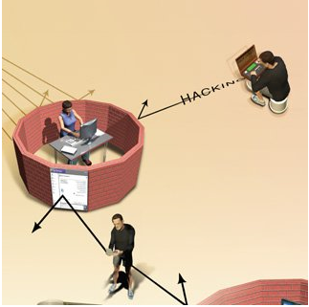
Introduction
Malware threats
Hackers
Internet is open for all to communicate; not the original idea during inception
“On the internet, no one knows you are a hacker”
Script Kiddies

Slide 3
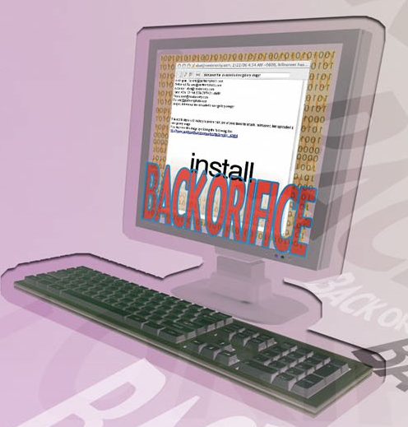
How hackers invade your pc
Back Orifice software
Can arrive either as an attachment to mail or
Through the Internet’s IRC Chat protocol
Tools can be used to verify whether Back Orifice is installed or not
Probing
BO uses port 31337
Hacker can copy or delete all files, data and software
Hacker can gain access to passwords
Hacker can upload or download any file

Slide 4
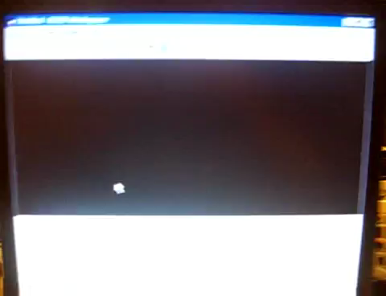
How hackers invade your pc

Slide 5
How script kiddies target pc
Damage people’s computers or websites with no great knowledge of computers
Run scripts (computer instructions, programs and codes) developed by others to launch attacks
Downloads malicious software and scripts for using the software
Launches the software that sends thousands of probes across internet
Probes look for vulnerable computers and Trojans without knowledge of users
Trojan activates as a response to the probe and sends message to the script kiddie with its own IP address
Script kiddie types IP address into malicious software
Software contacts Trojan and allows script kiddie to take control over the PC

Slide 6
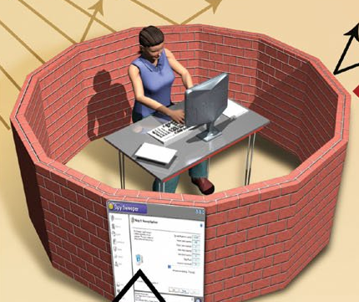
How personal hacker protection works?
Use PC with personal firewall
Blocks inbound traffic
Use Anti-spyware or anti-virus
Scans for any malware
Download and install latest patches in operating system
Ensures that the operating system is up to date and secure
Use Anti-spam software
Protects against hacking
Prevents spam recipients from clicking spam links
Use pop-up killer
Built on internet explorer, firefox and other browsers to prevent installation of Trojans through pop-ups

Slide 7
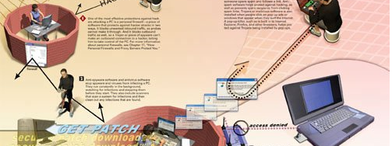
Thank you
Sharada Valiveti

